Slide 1

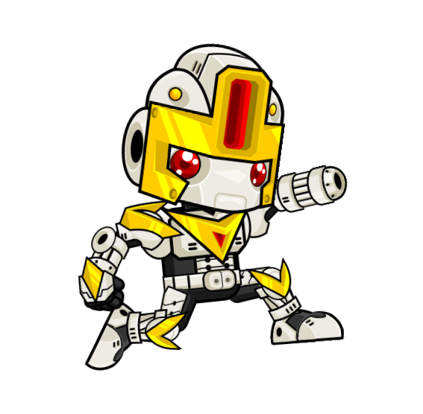

Slide 2
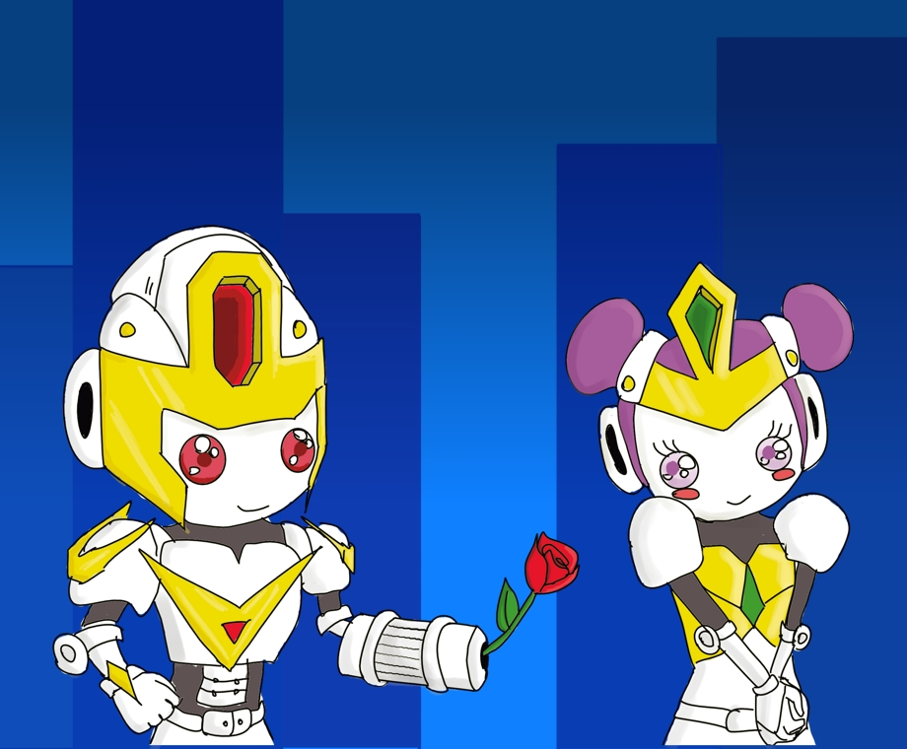
Story
The main character, Isaac, after an accident, saw his girlfriend go into pieces after his eyes.
The different pieces felt on different planets.

Slide 3

Story
He goes on an adventure to save his girlfriend. He will try to pick all the missing pieces to rebuild his girlfriend and be happy again.

Slide 4
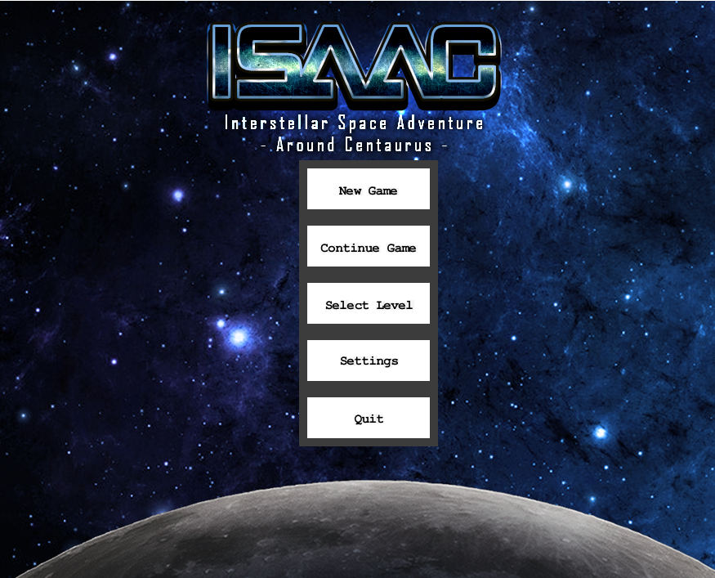
Main Menu’
This is the screen showed as soon as the game is started.
From here you can start a new game, continue from a previous save or select one of the already completed levels.

Slide 5
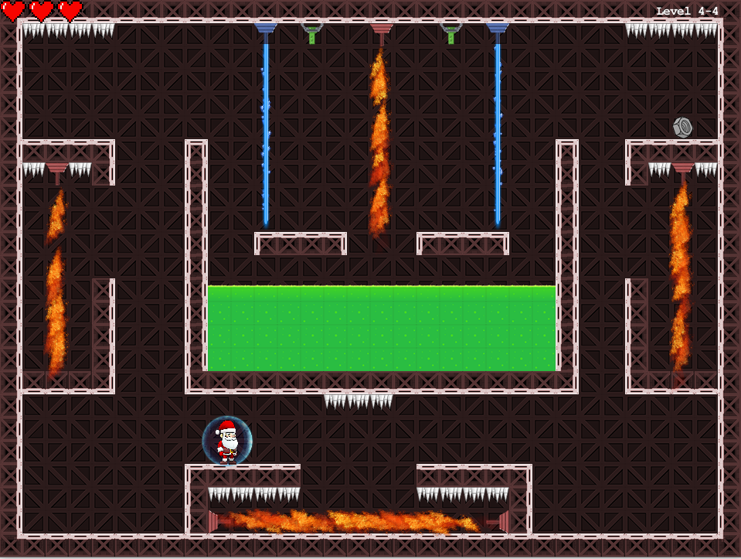
Gameplay
In each level you have to pick a fixed number of missing objects. You will go through different obstacles, like shooting turrets, spikes, acid lakes and so on.
To help you during this mission, you can pick different power-ups to get some benefits.
The actual demo will be showed at the end.

Slide 6

Game architecture
Used Technologies and Software architecture

Slide 7





Used technologies

Slide 8

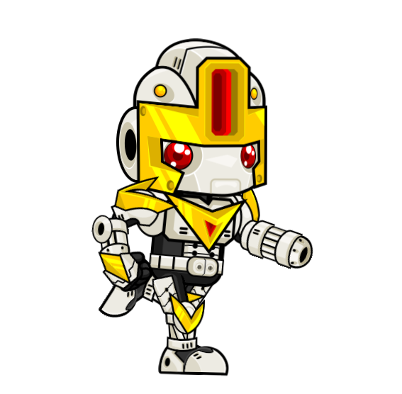
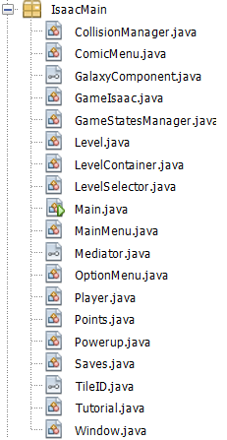
Game architecture
Package IsaacMain contains the system main classes. Among the classes that have a greater impact in the Architecture there are:
CollisionManager :
This class is made to check if the player interacts with any of the entities in the game.
GameIsaac:
This class manages the updating and rendering processes, both for the players and the world levels.
Level:
It serves to create all the level components. It is the actual scenario that the player is playing in.
Player:
Is the actual player. It has all the methods that are used to move the main character inside the scenario, with its stats.

Slide 9
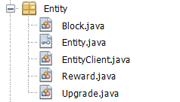
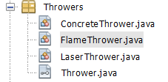
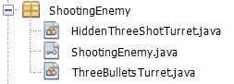
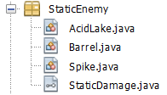
Game architecture
We divided what we tought as Entities that cannot deal damage in:
-Blocks that build the level structure.
-Rewards that are collected during the game.
-Upgrades that can be collected to enanche the player capabilities.
All sharing the same interface Entity.
Second Sprint (05-12 -> 11-12)
We divided what we tought as StaticTurret that «shoot» in a single direction:
-FlameThrowers that «shoot» flames and LaserThrower that are basically lasers.
All Sharing the same interface Thrower.
We divided what we tought as ActiveTurret that can «follow» the player in:
-ThreeBulletsTurret that can shoot three bullets after stopping for a fixed amount of time.
-HiddenThreeShotTurret that are visible only when the player enters a certain area.
All sharing the same interface ShootingEnemy.
We divided what we tought as StaticEnemies that cannot move but can deal damage:
-Spikes that «grow» from the ground.
-Barrels.
-AcidLakes in which you can fall.
All sharing the same interface StaticDamage.

Slide 10
Used Patterns
Creational, Structural and Behavioural design patterns.

Slide 11
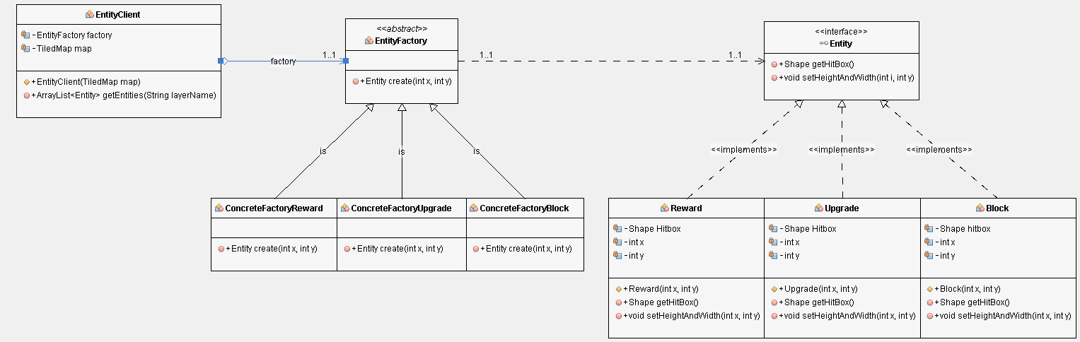
Factory Method Entities

Slide 12
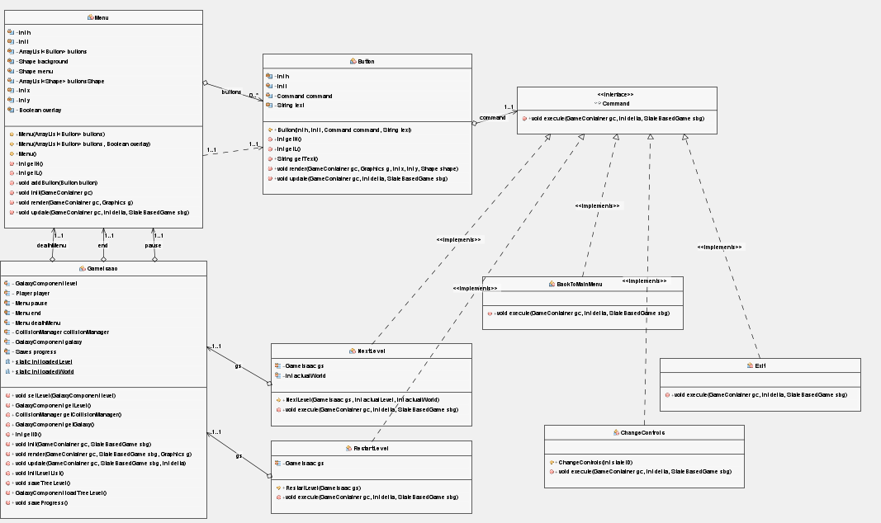
Command – Menu’

Slide 13
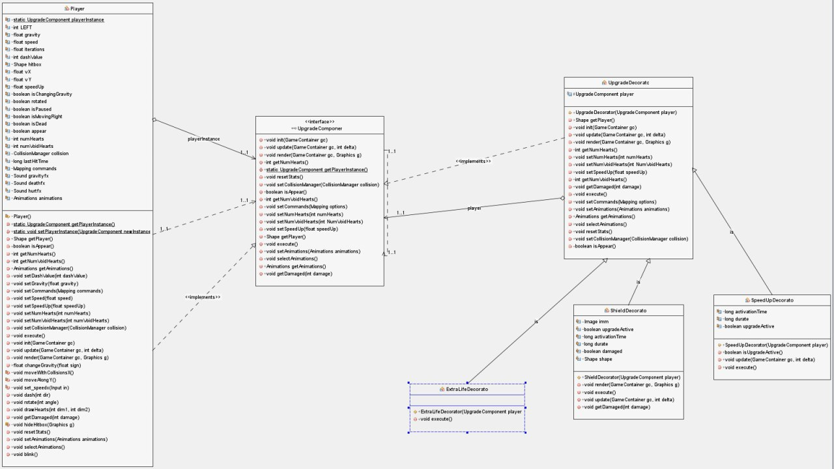
Decorator

Slide 14
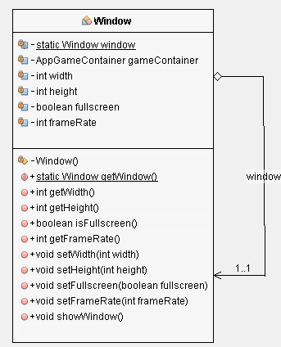
Singleton

Slide 15
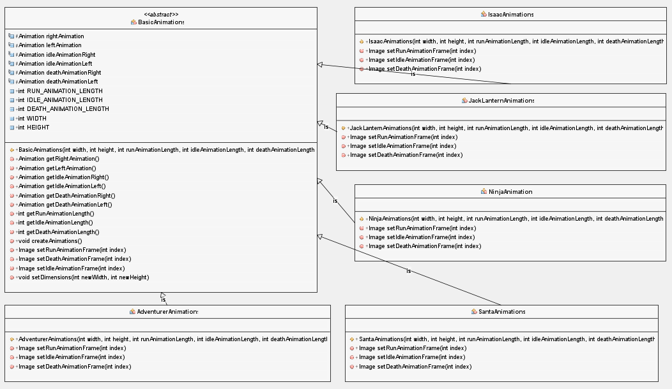
Template Method

Slide 16
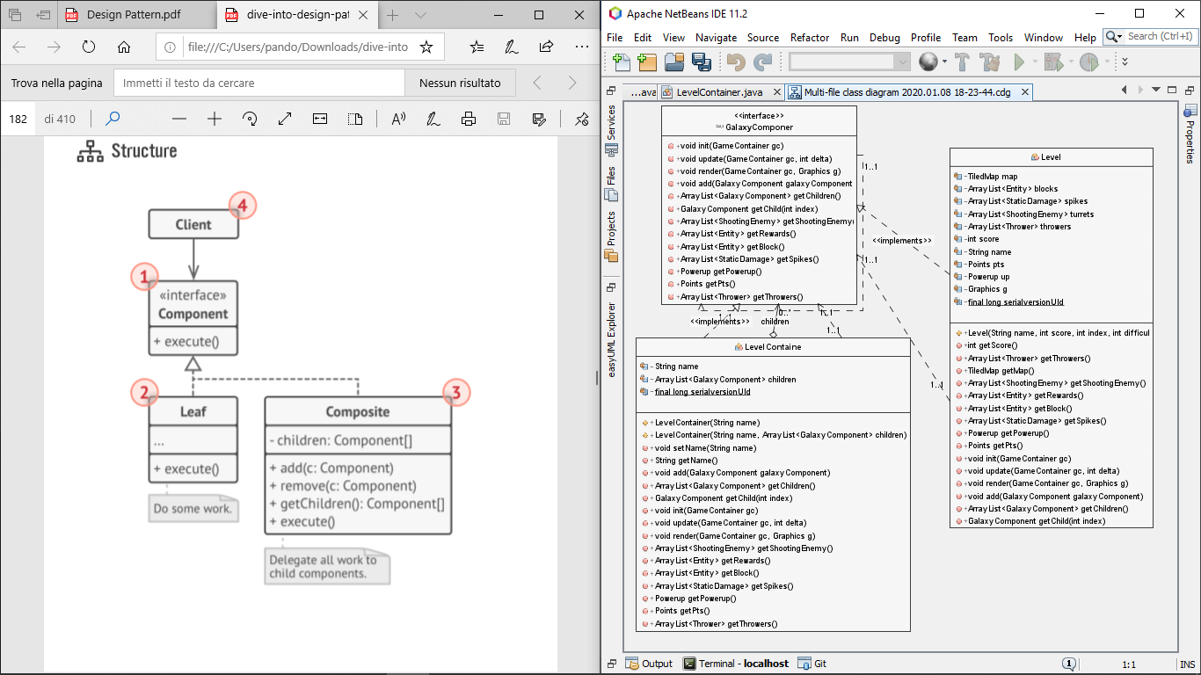
Composite

Slide 17
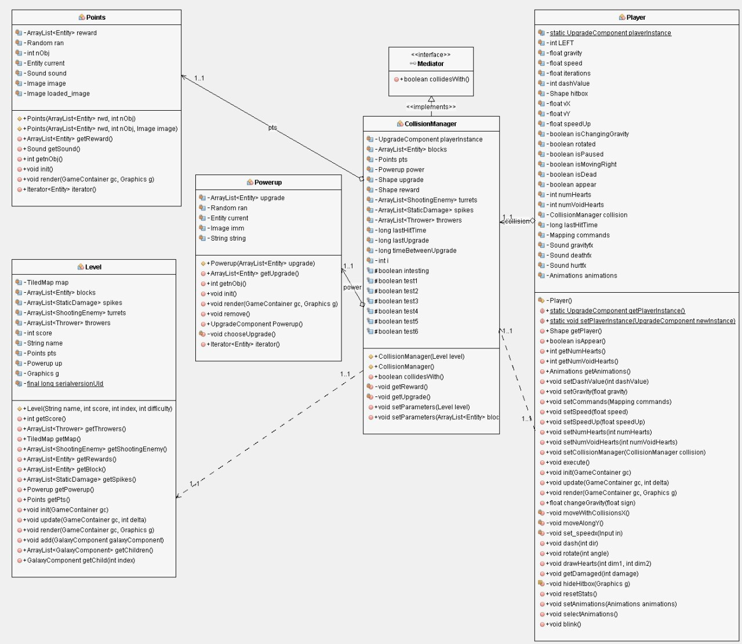
Mediator

Slide 18
SCRUM
How we applied the Scrum methodology.

Slide 19
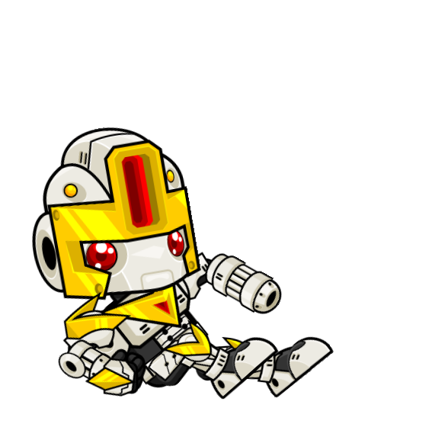
Roles:
1 Week duration
2 Week duration
1 Sprint
Adriano Luongo
Daniele Angellotto
2 Sprint
Michele Oliva
Simone Cristofaro
3 Sprint
Fabrizio Ciaramella
Marco Cavalcante
4 Sprint
5 Sprint
Giuliano Pandolfi
Lorenzo Mignella
Daniele Angellotto
Giuliano Pandolfi
P.O:
S.M:

Slide 20
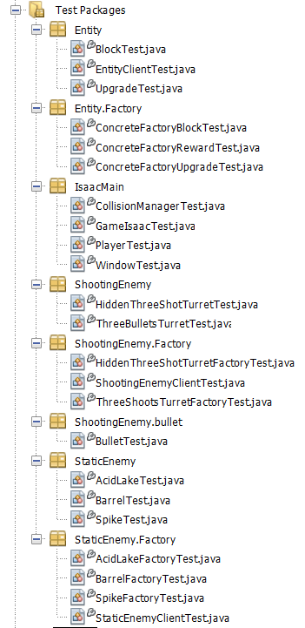
Testing:
Part of the classes were tested individually, following a white-box approach, by those who implemented these classes. The tests carried out in this way are present in the Test package.
A lot of other tests required to be done graphically:
A multitude of classes need to render images on the screen, while others need a player (beta tester) who tries to break the constraints by playing the game.
Done: unit and integration test, final acceptance test done by every member of the group.

Slide 21
Agile practices adopted:
- SCRUM , with related User Stories and Story Points.
- Daily meeting ALMOST in every working day to talk about progresses and problems encountered. This helped us increasing our velocity since it often happened that someone could help a team member by suggesting a solution to a problem he already faced.
- Pair programming: Some of us used this practice encountering a decrease in velocity but an improvement in the quality of code.
- MAX Communication to prevent someone from getting stuck in a bug for too long.
- Sprint review and product backlog refinement, to learn from mistakes and improve as a group.

Slide 22
Sprints
Overall evaluation
28/11/2019 -> 08/01/2020

Slide 23
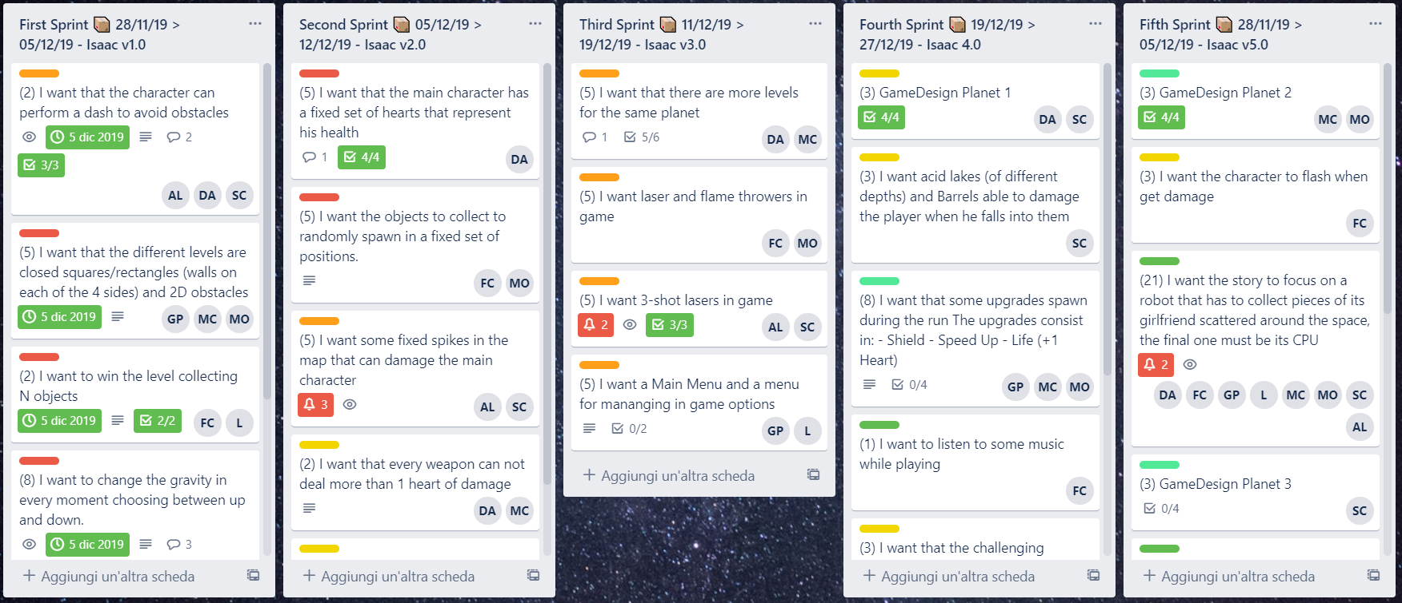

Slide 24
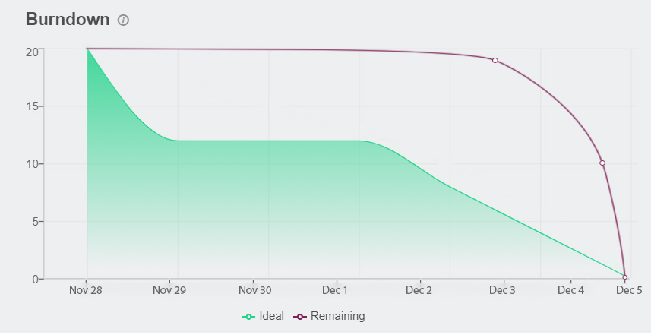
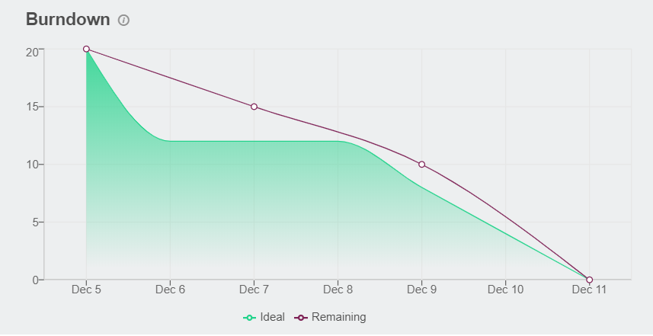
First three sprint:
During the first three sprints we needed time to learn how to use the library and how to work in a team. These are the three burndown charts that have already been shown in previous presentations. Each of these sprints lasted a single week.

Slide 25
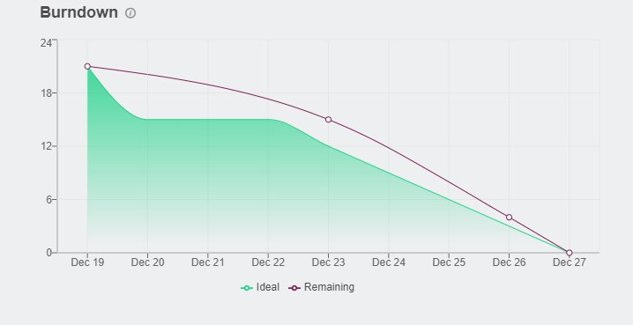
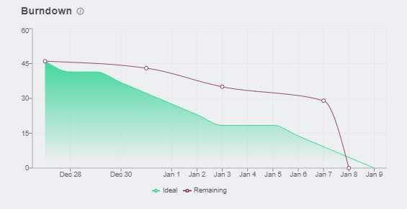
Last two sprints:
The fourth sprint was in the average. Despite the Christmas holidays and the team's commitments they managed to complete 18 set points. In fact, it has managed to bring an additional story into the sprint of 3 historical points, provided in 21 historical points.
The last sprint was programmed to last a week longer than the previous sprints. 45 SPs were achieved.
During these two weeks many difficulties were encountered and this can be seen from the burndown-chart.
Christmas commitments and the big amount of SP confused as at the beginning and slowed us down.
The big amount of SP made the merge of the various branches and therefore the integration more difficult.

Slide 26


Overall Sprint Review
- MORE OF -
Commented code and planning improvements
- START -
Use Github correctly
- KEEP DOING -
Talk to each other
- LESS OF -
Stories with dependecies
- STOP -
Doing cowboy-programmers
Some problems emerged in applying the Scrum methodology at the beginning, but with the passing of the time, the general objective of improving our collaboration was achieved.

Slide 27
Sprint Review:
During the sprints we learned to face problems such as:
-Communication problems: several conflicting ideas regarding implementation.
-Parallelism problems: it often happened to have connected stories that presupposed the presence of previous stories already developed.
-Problems in defining the tests: many of the tests carried out were carried out using the graphic output. The definition of test classes has led to problems that have never been faced before.
-Problems in planning the sprint: after each sprint it became clear that the planning carried out in the previous retrospective had flaws.
Having tried all the roles, it was possible to understand the difficulties of each role, noting the difficulty in maintaining a constant basic idea (due to the continuous change of roles).

Slide 28
DEMO
Actual gameplay of the game.

